Slide 1

REAL-TIME FACE MASK DETECTION
USING OPENCV
CSE-6363-004 MACHINE LEARNING
Professor:- Jesus Gonzalez Bernal
Group-7
Team Members:-
Rupeshwaran Ravindrran
Eswar Pavan Maganti
Kaza Goutham Kumar
Satyendra Paruchuri

Slide 2
PROJECT DESCRIPTION
The aim of this project is to develop a real-time face mask detection system using Tensorflow, an open-source machine learning library. With the ongoing COVID-19 pandemic, face mask detection has become a crucial task in ensuring public health and safety. This system will use computer vision techniques to identify if individuals in a video stream are wearing a mask or not.
The project will involve training a deep learning model on a dataset of masked and unmasked faces to accurately classify the presence or absence of a face mask. Tensorflow's high-level API, Keras, will be used to build and train the model. Transfer learning will also be applied to fine-tune a pre-trained model, on MobileNetV2.
The system will be developed to run in real-time on a live video stream. To achieve this, the OpenCV library will be used for video processing and the trained Tensorflow model will be integrated with the application. The outcome of this project will be a highly efficient and effective real-time face mask detection system that can be deployed in various settings such as airports, train stations, hospitals, and other public places.

Slide 3
ABOUT DATA
We acquired the dataset from Kaggle, All the images with the face mask (~6K) are scrapped from google search and all the images without the face mask are preprocessed from the CelebFace dataset created by ASHISH JANGRA
To increase the model's precision, the dataset includes a diverse spectrum of racial and ethnic groups. The above dataset consists of almost 12K images which are almost 328.92MB in size.
(https://www.kaggle.com/datasets/ashishjangra27/face-mask-12k-images-dataset)

Slide 4
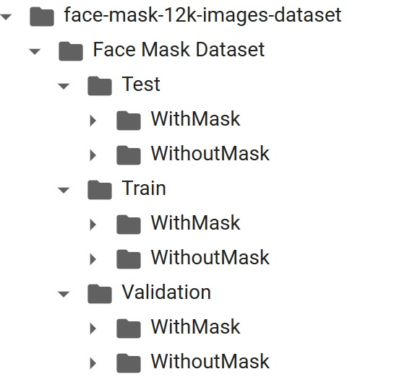
ABOUT DATASETS
The Datasets are further subdivided into two folders:
WithMask: Containing images with people wearing face masks.
WithoutMask: Containing images with people without face masks.

Slide 5
ABOUT DATASETS
The dataset is subdivided into 3 folders:
Train: This data set is used to train the model and help it discover any hidden characteristics or patterns in the data. In each epoch, the same training data is fed to the neural network architecture repeatedly, and the model continues to learn the features of the data. A diverse collection of inputs should be included in the training set so that the model can be trained on all possible scenarios and be able to forecast any unanticipated data sample that might arise in the future. This section compiles about 80% of the dataset.

Slide 6
ABOUT DATASETS
Validation: Our model's performance during training is verified using the validation set, a set of data that is distinct from the training set. We can adjust the model's hyperparameters and configurations using the data from this validation procedure. It functions similarly to a critic telling us whether or not our training is on the right track. The model is trained on the training set, and, simultaneously, the model evaluation is performed on the validation set after every epoch. The major goal of dividing the dataset into a validation set is to prevent our model from overfitting, which occurs when the model gets exceptionally good at identifying samples in the training set but struggles to generalize to new data and make accurate classifications.
Test: The test set is a separate set of data used to test the model after completing the training. It provides an unbiased final model performance metric in terms of accuracy, precision, etc.

Slide 7
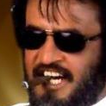
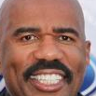
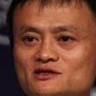

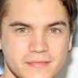
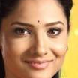
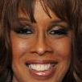
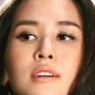
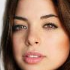
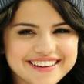
DIVERSITY OF DATASET:

Slide 8
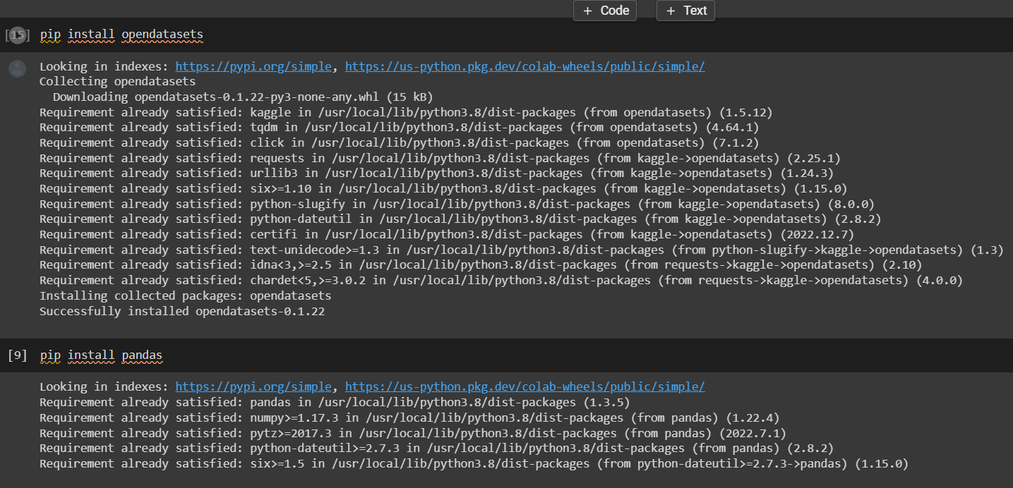
LOADING DATASET
Installing Required Libraries:

Slide 9
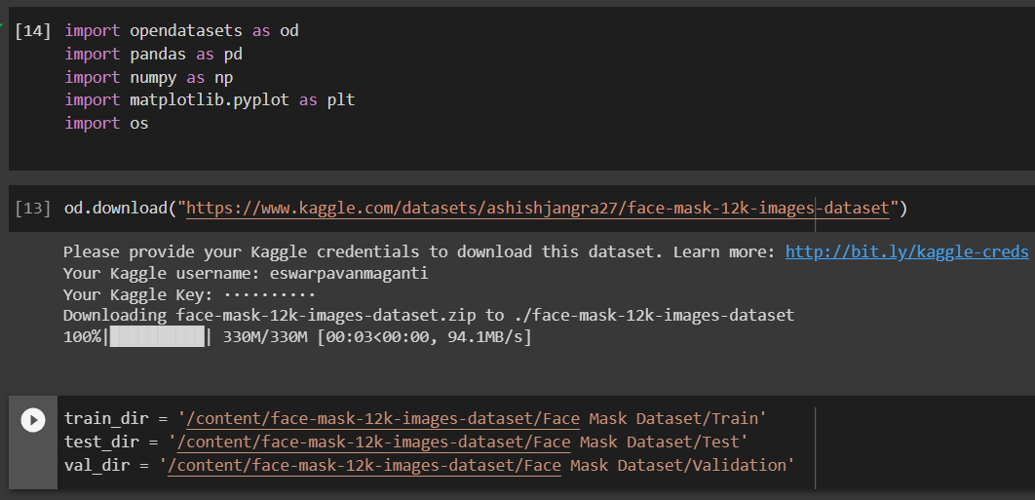
LOADING DATASET
Importing Libraries and Linking the dataset:

Slide 10
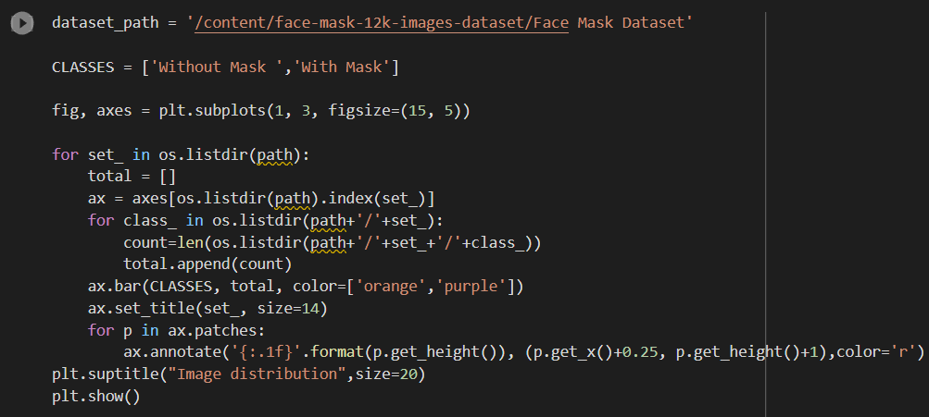
DATA VISUALIZATION
Code Snippet for data visualization:

Slide 11
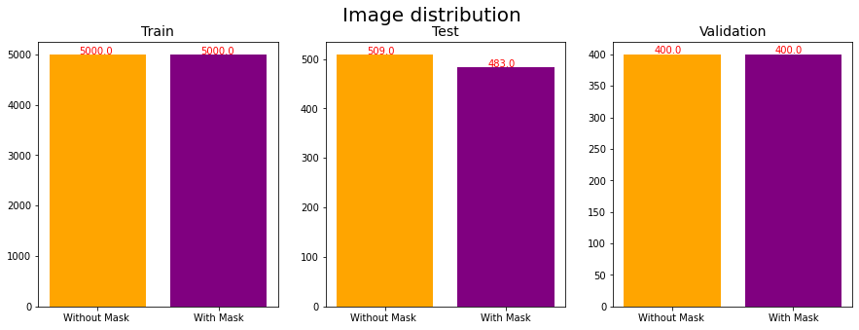
DATA VISUALIZATION
Bar Graph for Data Visualization

Slide 12
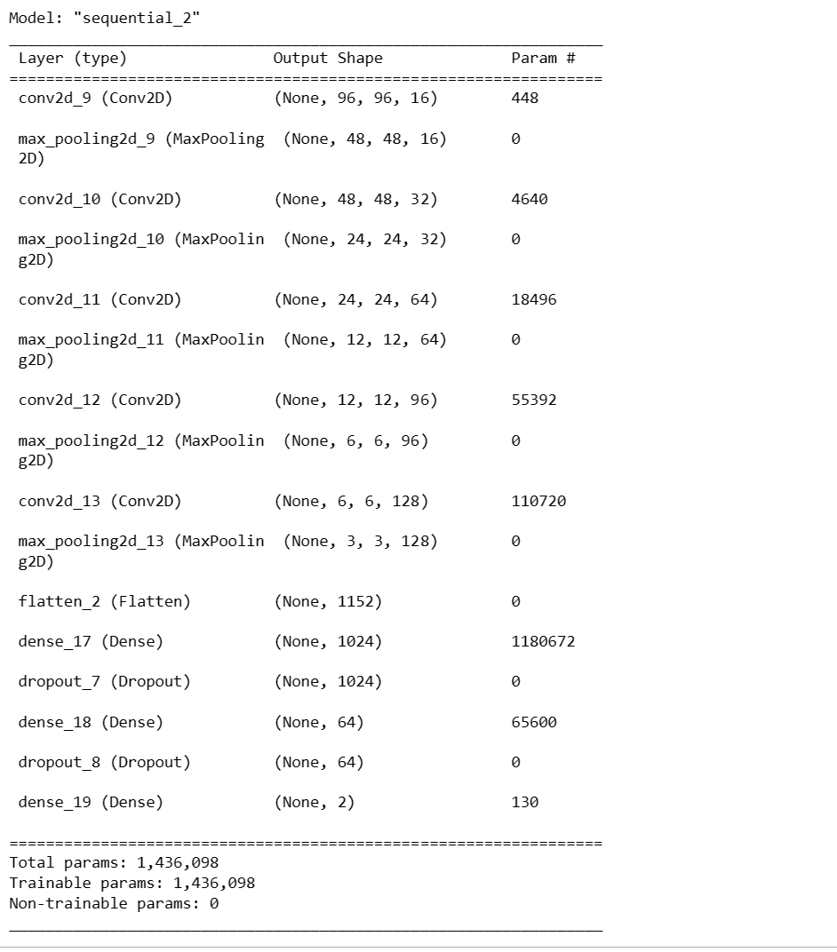
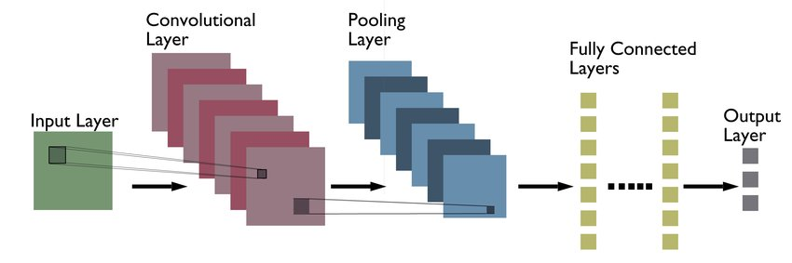
MODEL ARCHITECTURE

Slide 13
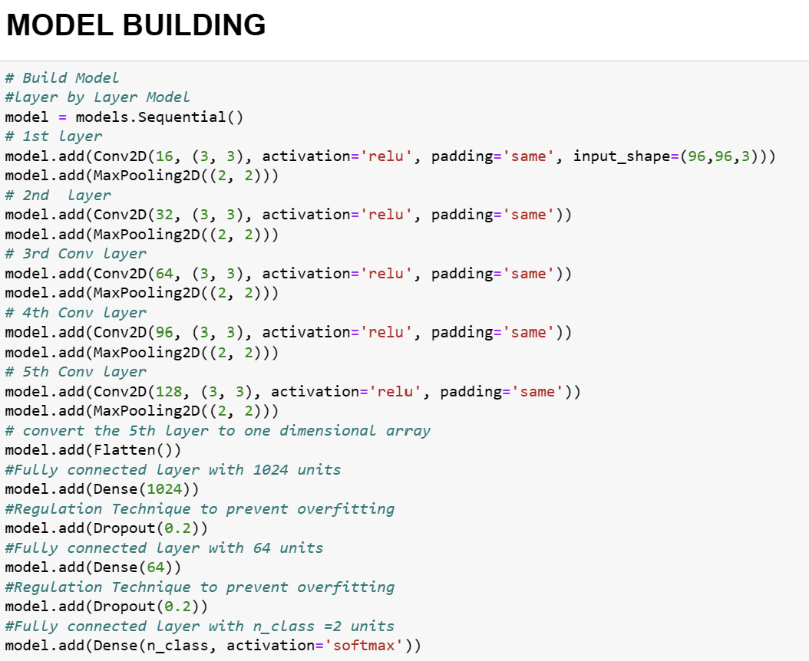
MODEL SNIPPET

Slide 14
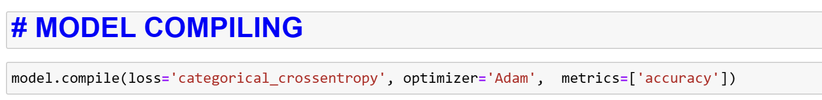
COMPILE MODEL
LOSS FUNCTION= CATEFORICAL CROSSENTROPY
OPTIMIZER= ADAM
METRICS= ACCURACY

Slide 15
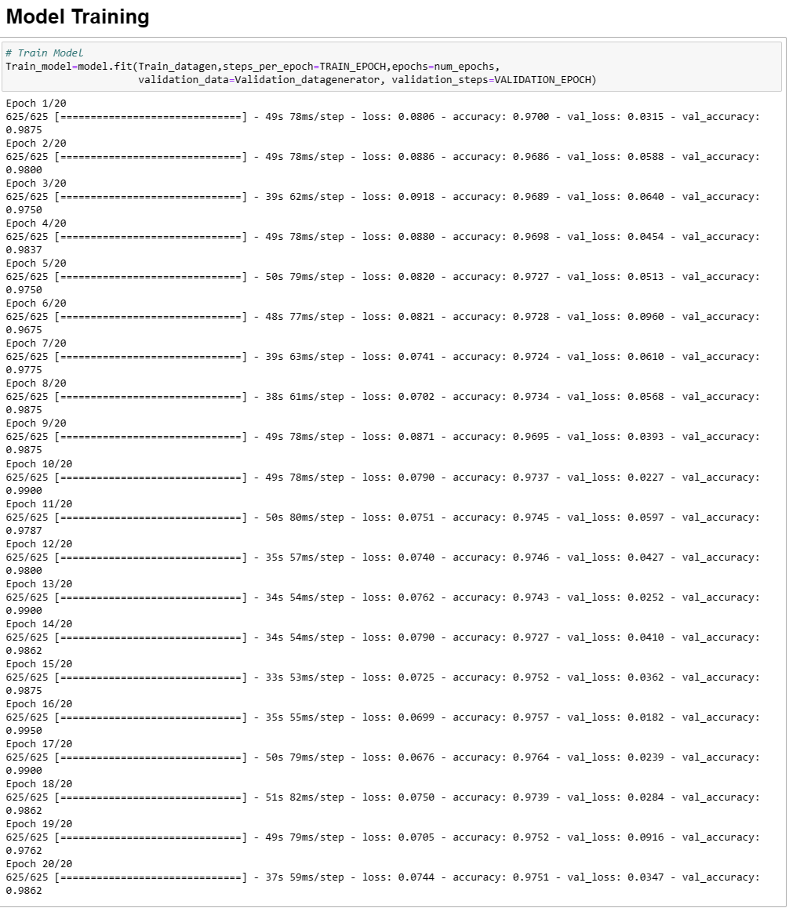
TRAINING MODEL

Slide 16
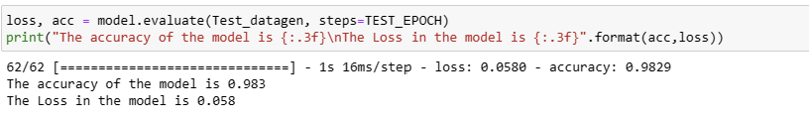
EVALUATE MODEL
TEST LOSS = 0.058
TEST ACCURACY = 0.983

Slide 17
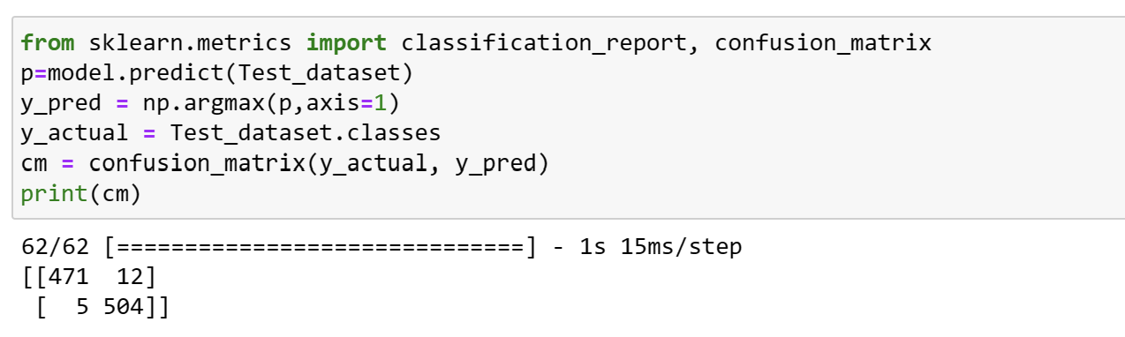
CONFUSION MATRIX

Slide 18
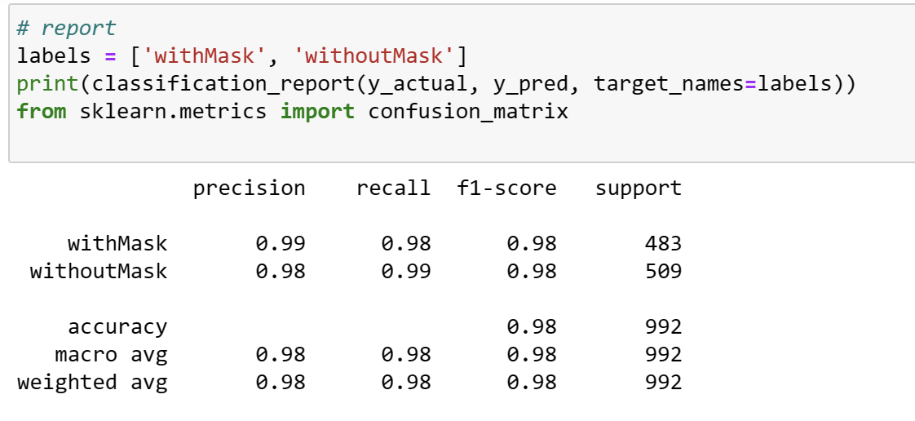
ACCURACY REPORT

Slide 19
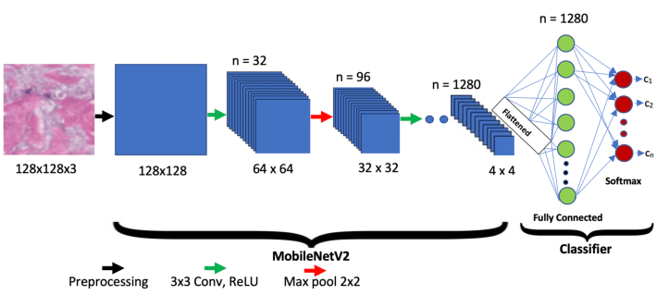
MobileNetV2
MobileNetV2, a lightweight convolutional neural network designed for mobile and embedded vision applications. The head fully-connected (FC) layers of the baseModel are excluded by setting the include_top parameter to False. This is because the FC layers of the pre-trained model are specific to the ImageNet dataset and would need to be modified for the new facemask detection task.The code then constructs a new headModel to be placed on top of the baseModel. The new headModel consists of average pooling, flattening, two dense layers, and dropout regularization. This is a typical practice in transfer learning where the pre-trained model is used as a feature extractor and a new set of trainable layers are added on top to learn task-specific features.
Finally, the headModel is placed on top of the baseModel, and the resulting model is compiled and trained using the new facemask dataset. The baseModel's layers are frozen by setting layer.trainable = False, ensuring that the pre-trained weights are not updated during the first training process
In summary, transfer learning is used in the given code by leveraging a pre-trained MobileNetV2 model as a feature extractor and training a new set of layers on top to learn the specific task of facemask detection. By freezing the pre-trained layers, the model can learn the new task more efficiently and with fewer training data.

Slide 20
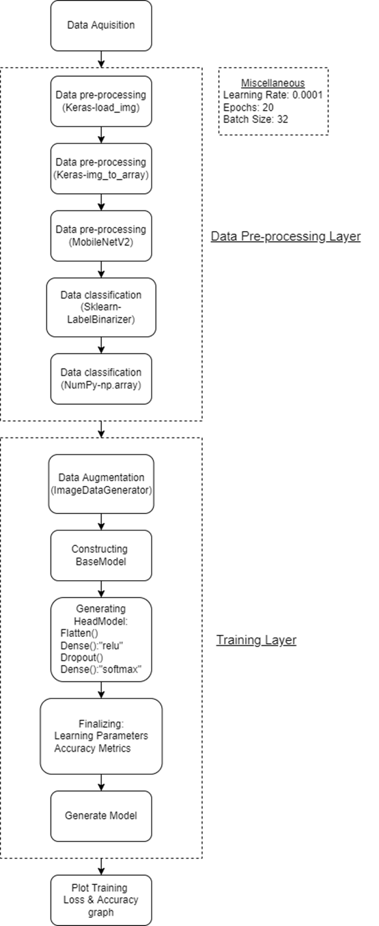
TRAINING ARCHITECTURE
1. Data Acquisition
In the first step, let us visualize the total number of images in our dataset in both categories. We can see that there are 6000 images in the ‘With Mask’ folder and 6000 images in the ‘Without Mask’ folder.
2. Data Preprocessing Layer
In the next step, we initialize all the required data structures to best suit our training architecture. This includes:
• Loading image data sets into keras (Keras-load_img)
• Loading image into array structure (Keras-img_to_array)
• Converting image Labels to array values (Sklearn-LabelBinarizer)
3. Training Layer
In this step, we train our model to ensure maximum accuracy and minimum loss for detecting mask by generating:
• Analytic parameters
• Base Model
• Head Model
4. Plot Training and Accuracy Graph
In the next step, we analyze our generated model for various parameters:
• Train_loss
• Value_loss
• Train_acc
• Val_acc

Slide 21
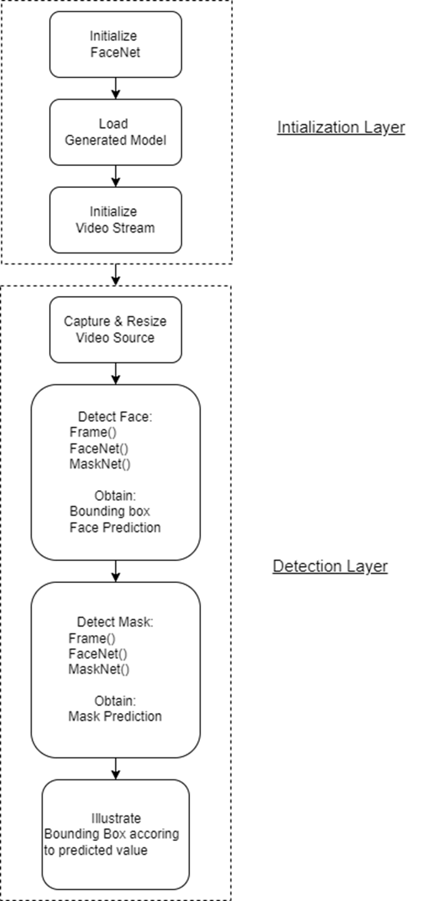
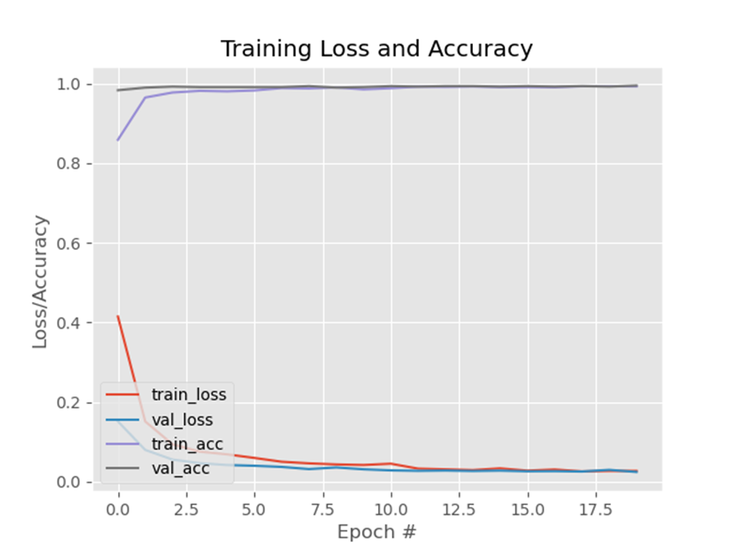
DETECTION ARCHITECTURE
5. Initialization Layer
After building our model, we initialize the detector module.
• Initialize FaceNet
• Load Generated Model
• Initialize Video Stream
6. Detection Layer
This step is the main step where the trained model is validated through various data sources by:
• Capture & Resize Video Source
• Detecting Face Layer
• Detecting Mask Layer
• Render Bounding Box according to prediction

Slide 22
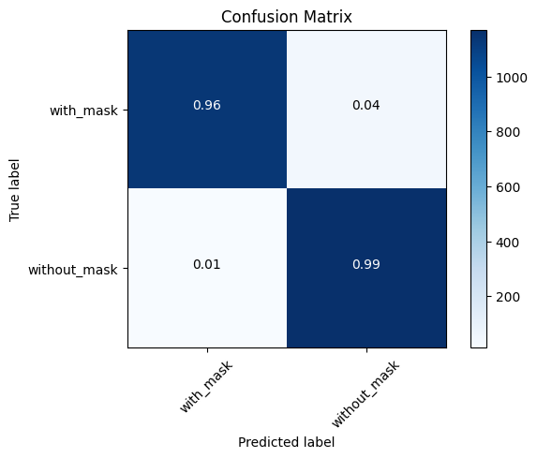
CONFUSION MATRIX

Slide 23
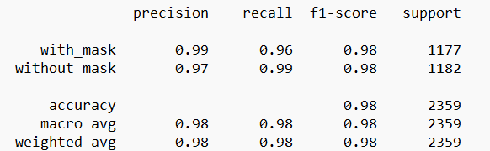
ACCURACY REPORT

Slide 24
CUDA
CUDA (Compute Unified Device Architecture) is a parallel computing platform and programming model developed by NVIDIA for GPU (Graphics Processing Unit) programming. It allows developers to harness the power of GPUs to accelerate compute-intensive applications.
Some key features of CUDA include:
Unified Memory: A single memory space for both CPU and GPU, which simplifies memory management and enables faster data transfer.
Parallel Processing: GPUs are designed to process many tasks simultaneously, allowing for significantly faster computation times than CPUs.
CUDA C/C++: A programming language based on C/C++ that allows developers to write code for the GPU using familiar syntax.
Libraries and Tools: CUDA comes with a wide range of libraries and tools, including cuBLAS for linear algebra operations, cuDNN for deep neural network training, and nvprof for profiling and debugging.
Overall, CUDA provides a powerful platform for developers to take advantage of the massive parallel processing capabilities of GPUs and achieve significant performance gains for their applications.

Slide 25
CUDA
CUDA (Compute Unified Device Architecture) is a parallel computing platform and programming model developed by NVIDIA for GPU (Graphics Processing Unit) programming. It allows developers to harness the power of GPUs to accelerate compute-intensive applications.
Some key features of CUDA include:
Unified Memory: A single memory space for both CPU and GPU, which simplifies memory management and enables faster data transfer.
Parallel Processing: GPUs are designed to process many tasks simultaneously, allowing for significantly faster computation times than CPUs.
CUDA C/C++: A programming language based on C/C++ that allows developers to write code for the GPU using familiar syntax.
Libraries and Tools: CUDA comes with a wide range of libraries and tools, including cuBLAS for linear algebra operations, cuDNN for deep neural network training, and nvprof for profiling and debugging.
Overall, CUDA provides a powerful platform for developers to take advantage of the massive parallel processing capabilities of GPUs and achieve significant performance gains for their applications.

Slide 26
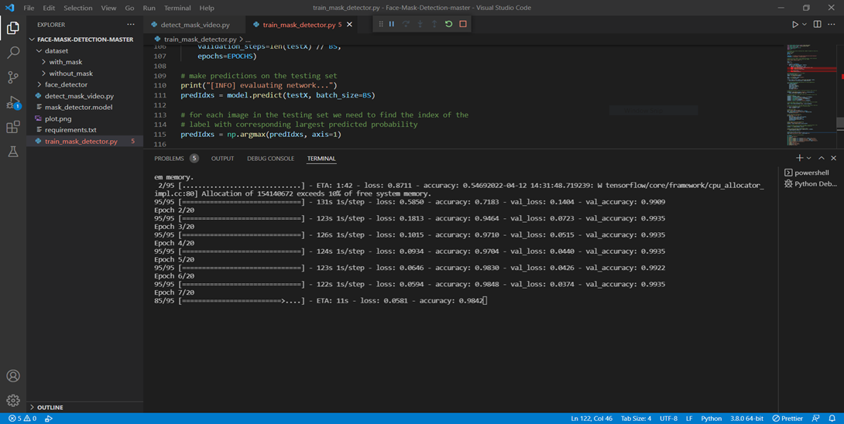
CPU VS GPU COMPARATIVE ANALYSIS:
CPU time consumption for training a batch of images (1 EPOCH 95 images) took a maximum of 131 sec i.e., 1sec/image on average.

Slide 27
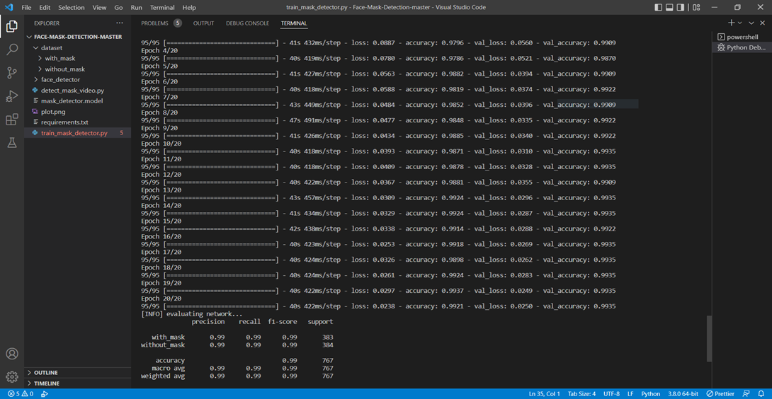
GPU time consumption for training a batch of images (1 EPOCH 95 images) took a maximum of 41 sec i.e., 420 millisecond/image on average.
Hence, we observe a 320% increase in average time consumption.

Slide 28
Enhancements from Reference:
The reference paper's performance is dependent on the video source's frame rate, whereas our implementation can handle varying frame rates of multiple input sources.
The reference paper executed the model on the CPU, whereas our implementation utilizes the GPU-accelerated CUDA architecture.
The reference paper employed the model on a restricted number of subjects, whereas our model accommodates a maximum of 10 subjects.
The reference paper demonstrates inaccurate detection on low-resolution video sources, while our implementation accommodates a diverse range of resolutions and formats.

Slide 29
References
[1] Bosheng Qin, Dongxiao LI, “Identifying Facemask-Wearing Condition Using Image Super-Resolution with Classification Network to Prevent COVID-19” College of Information Science and Electronic Engineering, Zhejiang University, Hangzhou 310058, China.
[2] Jong-Hoon Kim, Mohammad Marufur Rahman, MD. Motaleb Hossen Manik, Md. Milon Islam, Saifuddin Mahmud, “An Automated System to Limit COVID-19 Using Facial Mask Detection in Smart City Network” Conference: 2020 IEEE International IOT, Electronics and Mechatronics Conference (IEMTRONICS)At: Vancouver, BC, Canada.
[3] Mouna Aﬁf1, Yahia Said, Mohamed Atri, “Computer vision algorithms acceleration using graphic processorsNVIDIA CUDA” Electrical Engineering Department, College of Engineering,Northern Border University, Arar, Saudi Arabi.
[4] M. S. Ejaz, M. R. Islam, M. Sifatullah, A. Sarker, “Implementation of Principal Component Analysis on Masked and Non-masked Face Recognition” Conference: 2019 1st International Conference on Advances in Science, Engineering and Robotics Technology (ICASERT).
[5] Mamdouh M. Gomaa, Mahmoud M. Elsherif, Alaa Elnashar, Alaa M. Zaki, “Face Mask Detection Model Using Convolutional Neural Network” University in Minya, Egypt.

Slide 30
References
[6] COVID-19: Face Mask Detector with OpenCV, Keras/TensorFlow, and Deep Learning – PyImageSearch
[7] https://www.kaggle.com/code/tilasousa/face-mask-detection-using-keras-cnn
[8] https://www.kaggle.com/code/chinmayaudupa/face-mask-detection-using-cnn-and-deep-learning

Slide 31
THANK YOU

